Slide 1
Algorithmic Bias in Predictive Policing - An Assessment on Toronto's Cannabis Arrests
AI Ethics
Group 07
Anukul, Hayoung (Zoe), Rajkumar, Zeyu (Kehl)
Notes:
Hi everyone, today we’ll discuss algorithmic bias in predictive policing and our empirical bias assessment of the Toronto Cannabis Arrests dataset. Our group consists of Anukul, Rajkumar, Kehl, and myself.

Slide 2
CONTENTS
01 | Problem Description
02 | Ethical Considerations
03 | Data Description & EDA
04 | Empirical Bias Assessment
05 | Conclusion
Notes:
We'll walk you through our presentation in this order: First, we’ll cover the domain we chose, the ML techniques being used, and the ethical considerations surrounding them. Then, we’ll introduce our dataset and the results of our empirical bias assessment on it.

Slide 3
PROBLEM DESCRIPTION
01
02
DOMAIN: Policing in Criminal Justice System
ML: Person-Based Predictive Policing Algorithms
Widely used in both policing and judicial functions across the US
Utilize personal data such as age, gender, marital status, history of substance abuse, and criminal records to predict future criminal activity.
Tools like COMPAS (Correctional Offender Management Profiling for Alternative Sanctions)
COMPAS evaluates the likelihood of recidivism by assigning a risk score from 1 to 10, directly influencing judicial decisions on bail, sentencing, and parole.
Source : MIT Technology Review
https://www.technologyreview.com/2020/07/17/1005396/predictive-policing-algorithms-racist-dismantled-machine-learning-bias-criminal-justice/
Notes:
We chose policing in the criminal justice system as our domain. Predictive policing has fundamentally reshaped law enforcement strategies. This approach largely incorporates two main methods: location-based and person-based. We focused on a person-based algorithm, which has been widely used in policing and judicial functions across the US following the 2008 financial downturn and subsequent budget cuts to law enforcement. These algorithms utilize personal data such as age, gender, marital status, history of substance abuse, and criminal records to predict future criminality. COMPAS is one of the representative tools. It evaluates the likelihood of recidivism by assigning a risk score on a scale of 1 to 10, and this directly influences judicial decisions on bail, sentencing, and parole.

Slide 4
CONTENTS
01 | Problem Description
02 | Ethical Considerations
03 | Data Description & EDA
04 | Empirical Bias Assessment
05 | Conclusion
Notes:
Now, Rajkumar will explain the ethical considerations surrounding this predictive policing algorithms

Slide 5
ETHICAL CONSIDERATIONS
"There's a long history of data being weaponized against Black communities"
01
Systematic Discrimination
Primarily arises from the misuse of arrest data
Relevance - Arrest data regardless of conviction doesn't necessarily correlate with true criminal behavior or could be even against the minority communities that have been subject to disproportionate policing.
Generalization - Categorize individuals based on broad and often inaccurate demographic traits like race or zip code which overlooks individual behaviors but also perpetuates stereotypes affecting algorithm
Compounding Injustice - Biased data can lead to more police patrols in specific neighborhoods, increasing arrests and reinforcing a cycle of discrimination and social inequalities
Source : MIT Technology Review
https://www.technologyreview.com/2020/07/17/1005396/predictive-policing-algorithms-racist-dismantled-machine-learning-bias-criminal-justice/

Slide 6
ETHICAL CONSIDERATIONS
02
Measurement Errors
The use of proxies like zip codes, educational backgrounds, and socioeconomic statuses in algorithms acts as substitutes for race
This perpetuates racial stereotypes and systemic injustices by relying on demographics historically linked to discrimination, thereby fueling a cycle of biased criminalization and incarceration
03
Sampling Bias and Differential Subgroup Validity
Predictive tools like Static-99, developed in Canada where only 3% of the population is Black, exhibit bias when used in the U.S., where Black individuals comprise approximately 12% of the population, leading to unrepresentative training data
The accuracy and performance of tools like Static-99 vary across different demographic groups, generally underperforming for minorities due to their reliance on biased sampling
Source : MIT Technology Review
https://www.technologyreview.com/2020/07/17/1005396/predictive-policing-algorithms-racist-dismantled-machine-learning-bias-criminal-justice/

Slide 7
CONTENTS
01 | Problem Description
02 | Ethical Considerations
03 | Data Description & EDA
04 | Empirical Bias Assessment
05 | Conclusion

Slide 8
DATA DESCRIPTION
VARIABLES:
Includes 8 variables:
DATASET:
Cannabis Arrests in Toronto - Racial Disparities
5,226 observations of arrestee demographics across six years (1997-2002)
SOURCE: Kaggle
Variable | Description
released | Whether arrestee was released with a summons (Y / N)
color / race | Arrestee's race (Black / White)
year | 1997 through 2002
age | In years
sex | Male / Female
employed | Y / N
citizen | Y / N
Checks | # of police databases the arrestee's name appeared on
https://www.kaggle.com/datasets/utkarshx27/arrests-for-marijuana-possession/data

Slide 9
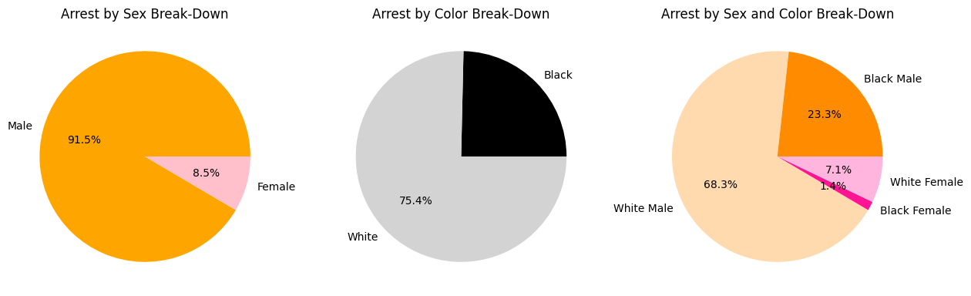
Arrest Rate by Sex and Color
Arrest by Sex
Arrest by Color
Arrest by Sex & Color

Slide 10
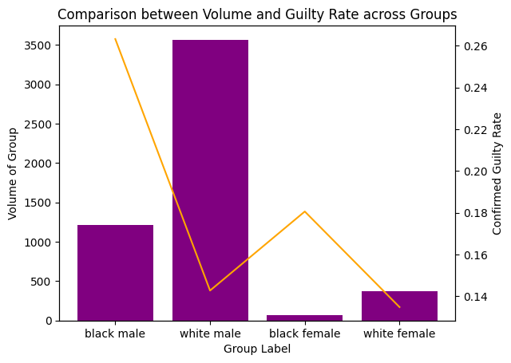
2. Arrest Numbers vs. Guilty Conviction Rate
White males are more than 20 times arrested in number than black female
Arrested black male are twice likely guilty than white female

Slide 11
CONTENTS
01 | Problem Description
02 | Ethical Considerations
03 | Data Description & EDA
04 | Empirical Bias Assessment
05 | Conclusion

Slide 12
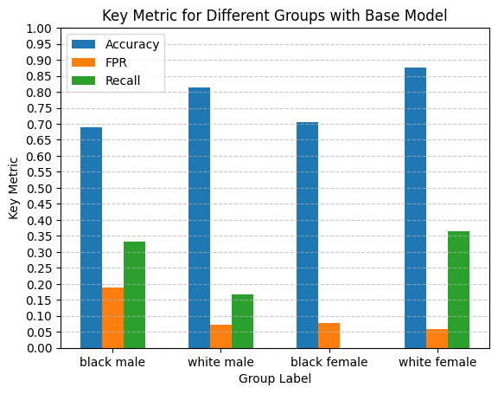
EMPIRICAL BIAS ASSESSMENT 0. The Base Model
Prominently high rate of wrongful arrest among Black individuals (Male or Female)
No detection for Black Females
Low True Positive Rate among White Males and Females

Slide 13
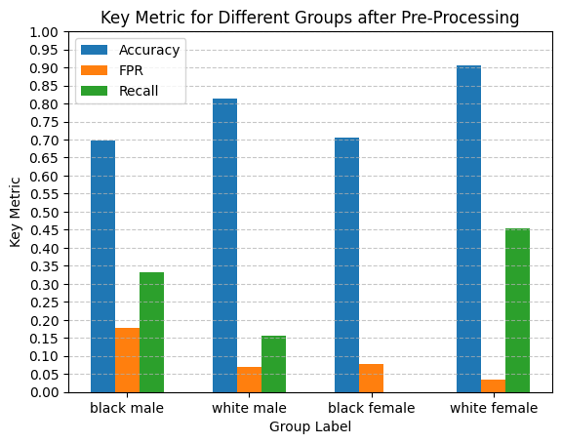
EMPIRICAL BIAS ASSESSMENT 1. Re-weighted Sample Data
A (very) slight improvement on subgroup recall & accuracy, but overall accuracy ~79%
Improved detection for White Females
Maybe sampling is not the true problem to our data...

Slide 14
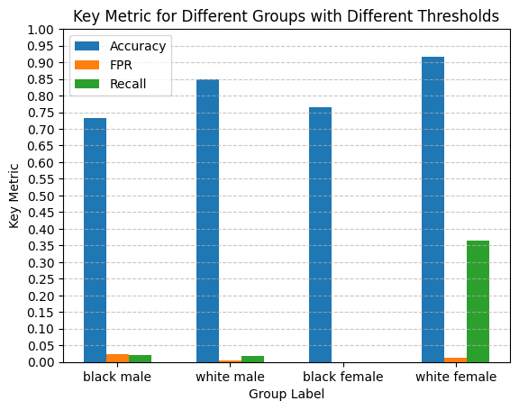
EMPIRICAL BIAS ASSESSMENT 2. Differential Subgroup Threshold
An observable improvement on subgroup and overall accuracy, also reduced FPR differences largely
But are we really going to arrest anyone according to the model?

Slide 15
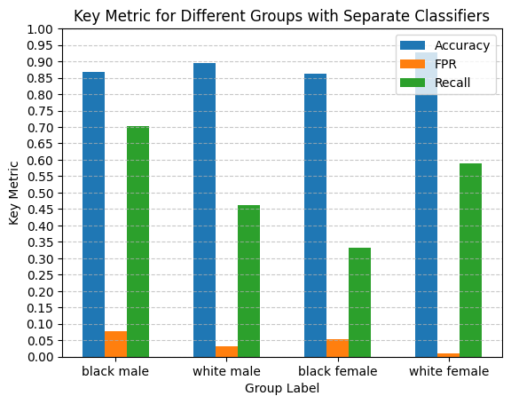
EMPIRICAL BIAS ASSESSMENT 3. Subgroup-Specific Classifiers
Prominent improvement on recall and effective balance of FPR, with overall accuracy increased to 89%

Slide 16
CONTENTS
01 | Problem Description
02 | Ethical Considerations
03 | Data Description & EDA
04 | Empirical Bias Assessment
05 | Conclusion

Slide 17



CONCLUSION
Found significantly higher guilt rates among Black males and females compared to White counterparts, but also associated racial biases that AI or ML technologies could oversee.
Implemented corrective measures such as reweighting and separate classifiers that demonstrated improvements in model fairness and accuracy for specific subgroups
Calling for carefully speculated AI or ML technologies that clearly identify demographic disparities in race, sex, and others, and thoroughly take into consideration of cross-group fairness as a performance measurement.

Slide 18
THANK YOU !

